Slide 1
Web pages presenting European Topic Centres in Eionet Portal:
Info-session on how to edit and structure content for ETC web content admins
24/01/2022

Slide 2
Agenda
Folders structure
Management of content
Some guidelines for consistency
Copying & moving content
Publish and unpublish
Plone toolbar
Q&A
NB: examples shown for various ETCs for illustrative purposes in subsequent ppts.

Slide 3
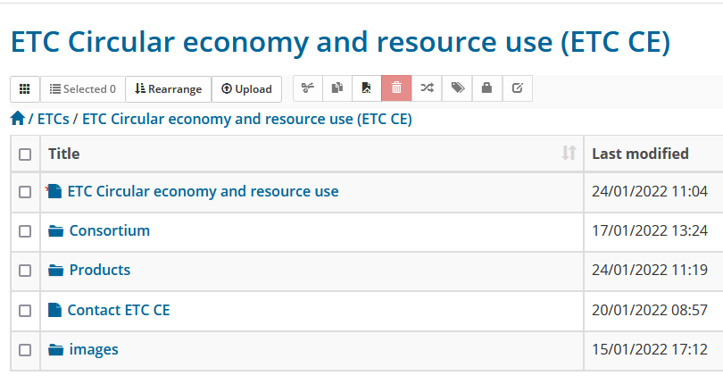
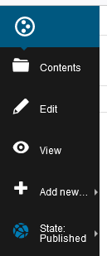
Folders structure
Page linked from menu
List of organisations in consortium
List of ETC products
Contact information
Upload images here
Additional folders - can be set up, if necessary

Slide 4
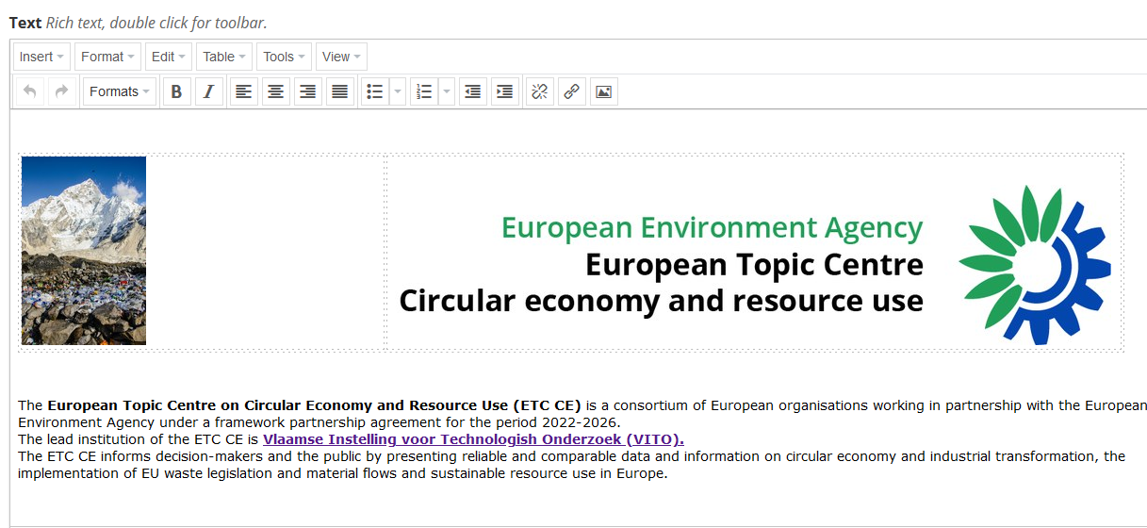
Management of content – consistency guidelines (1)
Page linked from menu

Slide 5
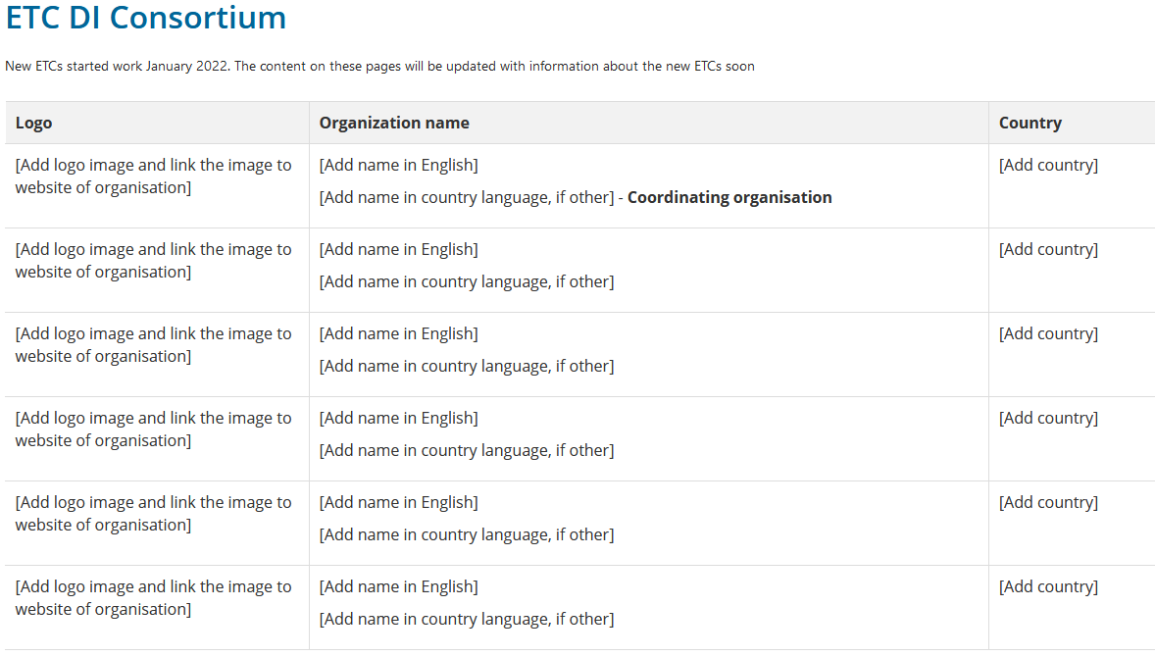
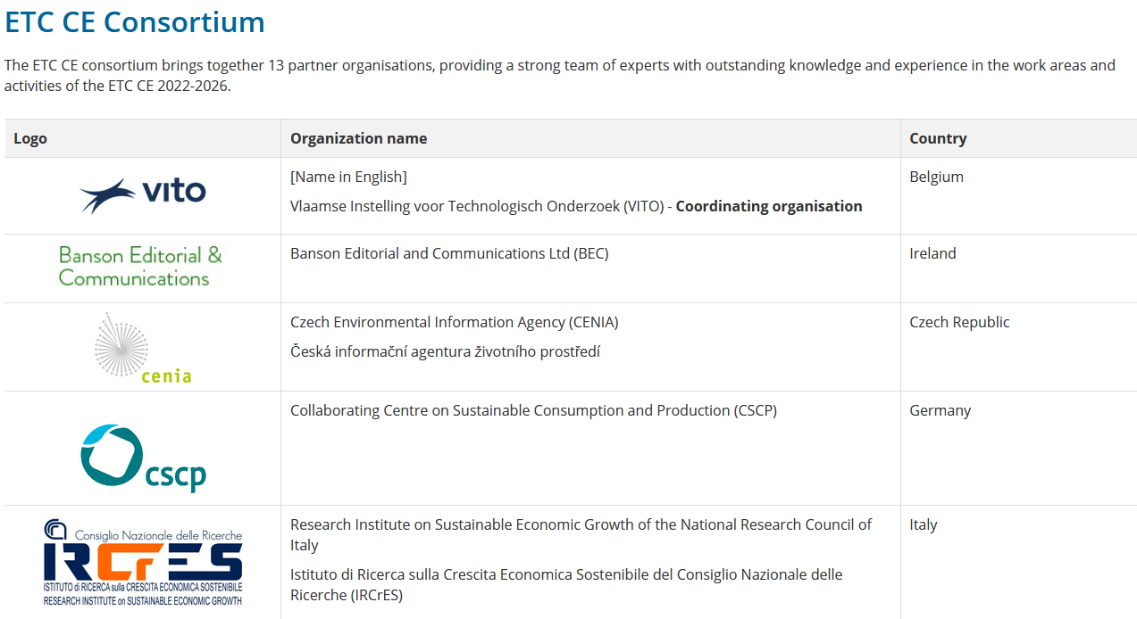
Management of content – consistency guidelines (2)
List of organisations in consortium
This slide has animation effects.
Viewed best in slide show mode.

Slide 6
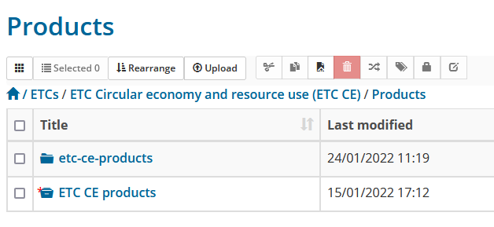
Management of content – consistency guidelines (3)
List of ETC products
Add Pdfs here
Don’t change this
Content that appears in red colour is not published

Slide 7
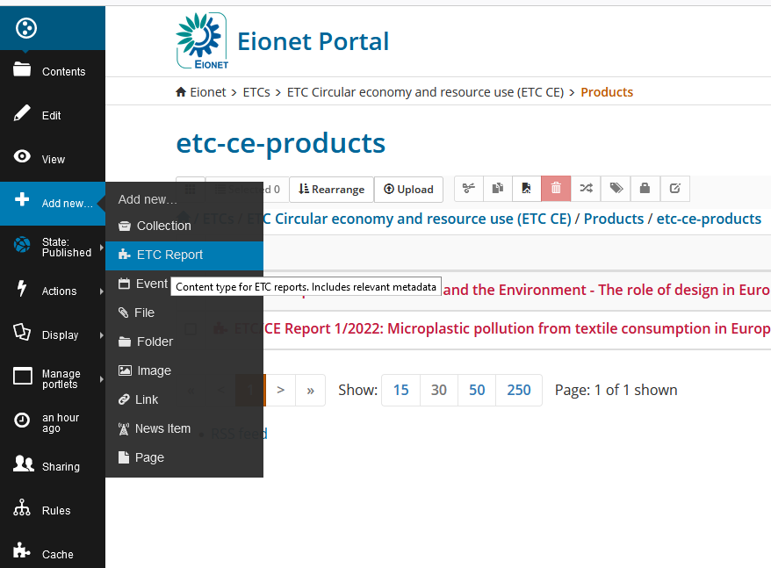
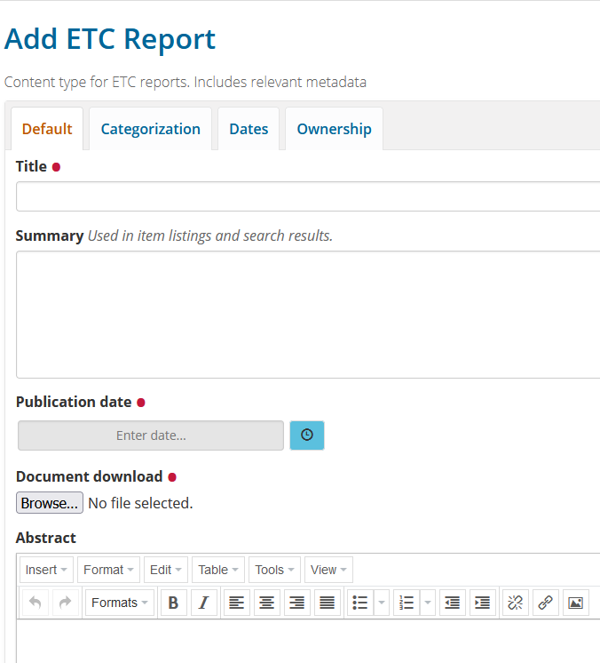
How to add a product?
1. Navigate to the folder where you want the file to be stored
2. In Plone’s admin bar, click on ‘Add new’ and choose ‘ETC Report’
3. Fill in the form:
Title
Publication date
Browse… to add file
Abstract
Save
Click once for ‘today’
Notes:
Tabs categorization, Dates and Ownership – do not change.
You can change ‘Dates’ in the Default tab

Slide 8
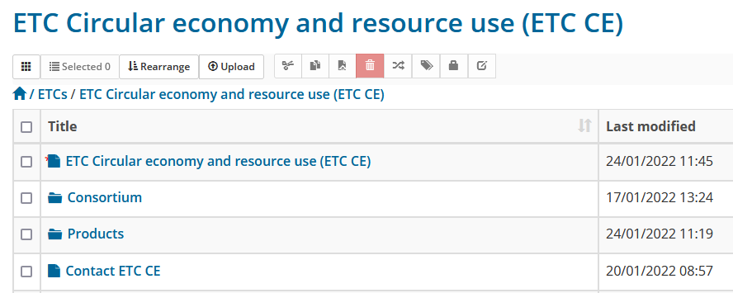
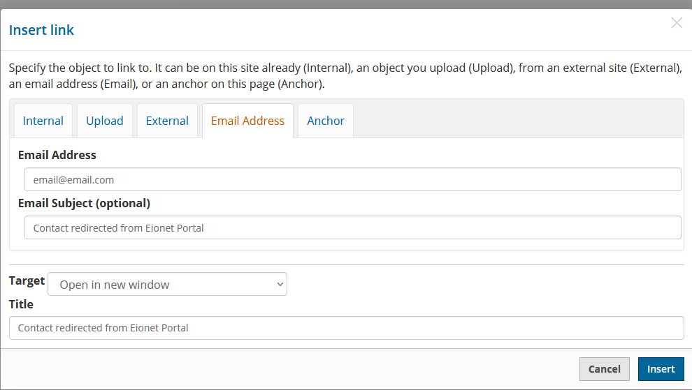
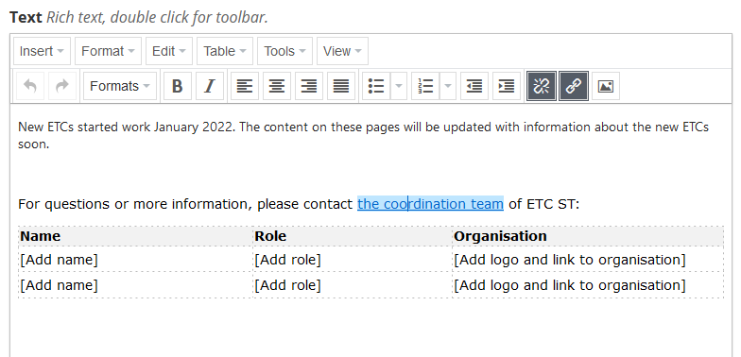
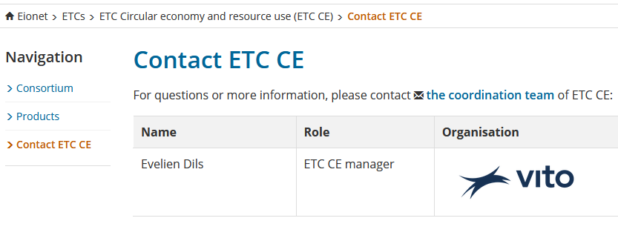
Management of content – consistency guidelines (4)
Contact information
This slide has animation effects.
Viewed best in slide show mode.
Notes:
Recommend not to publish personal email addresses for spam reasons

Slide 9
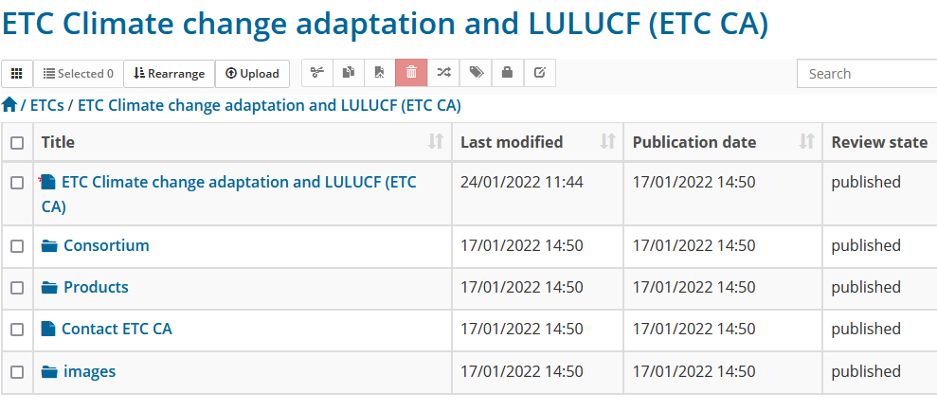
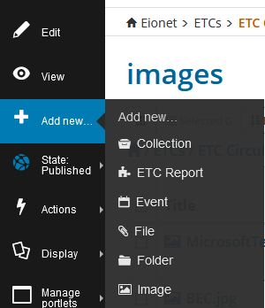
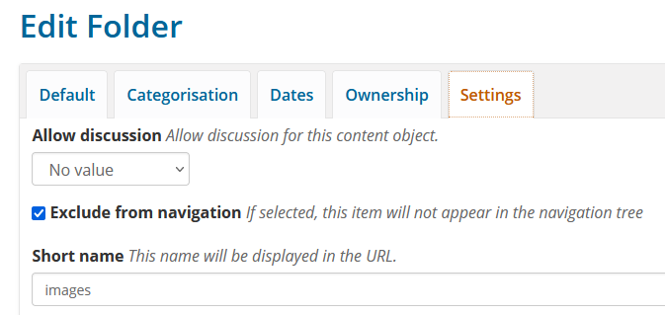
Management of content – consistency guidelines (5)
This slide has animation effects.
Viewed best in slide show mode.
Upload images here
1. Navigate to the folder images, where you want the images to be stored.
2. In Plone’s admin bar, click on ‘Add new’ and choose ‘Image’

Slide 10
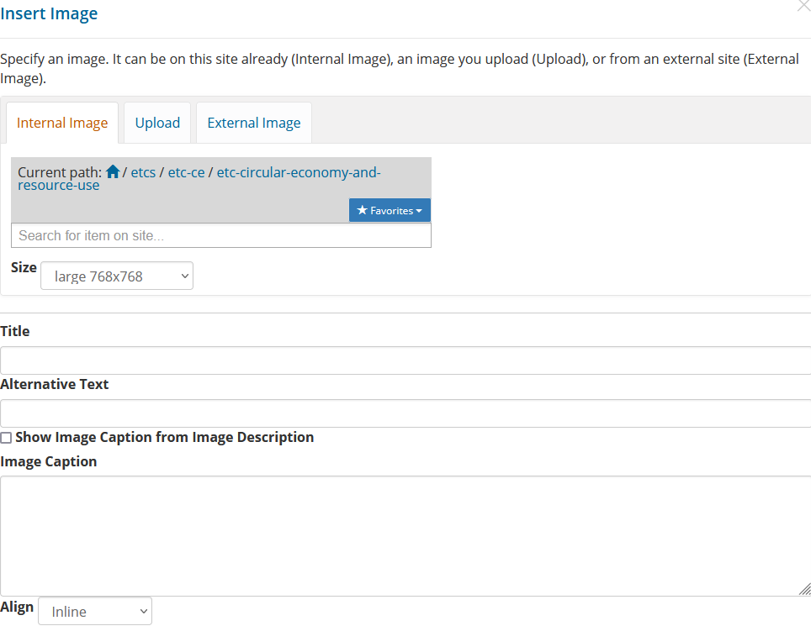
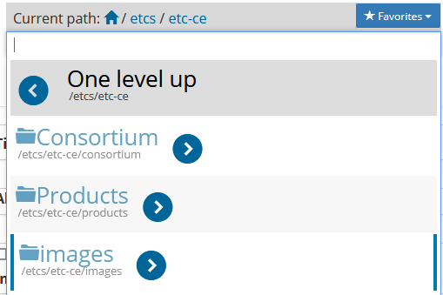
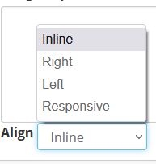
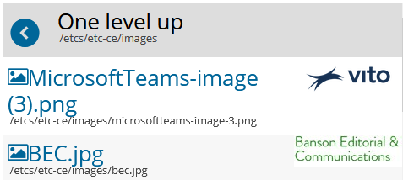
How to add images to pages?
1.
Insert/edit image
2.
3.
5.
4.
Choose the image
6.

Slide 11
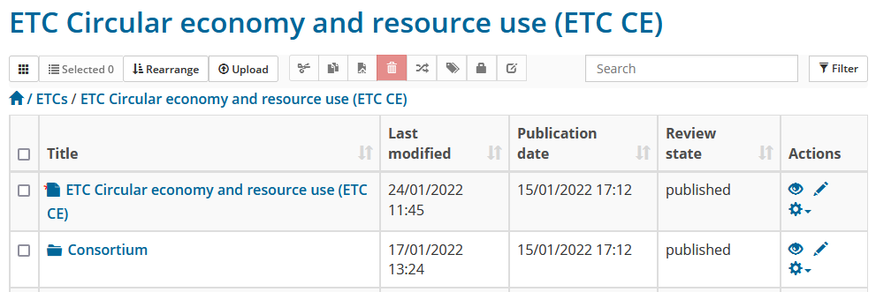
Copying and moving content
Control over ETC specific folder
Manage files and folders with content toolbar
Copy
Cut
Paste
Delete
Important!
There is no recycle bin – content item is really deleted.
In some situations, safer to unpublish.

Slide 12
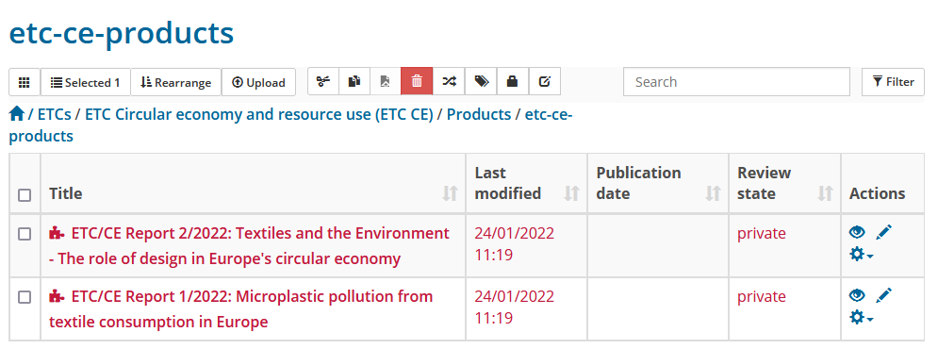
Publish and unpublish content

Slide 13
Note
The toolbar is visible on all pages where you have editing rights
Plone toolbar
See all content in the current folder and manipulate (copy paste delete), also in bulk
Add new content in the current folder, page, ETC report, images…
Publish and unpublish (hide) the current page
Display defines the default view of the current item, e.g. how folder contents are displayed
Manage the right-hand boxes for additional content
View the history of the current page and revert to older versions
Notes:
The toolbar is visible

Slide 14
Thank you.
Comments and questions are welcome.
ana.cardoso@eea.europa.eu
Q&A

